Slide 1

Piedmont Black Nurses Association
Advocacy. Support. Service. Scholarship. Mentorship.

Slide 2
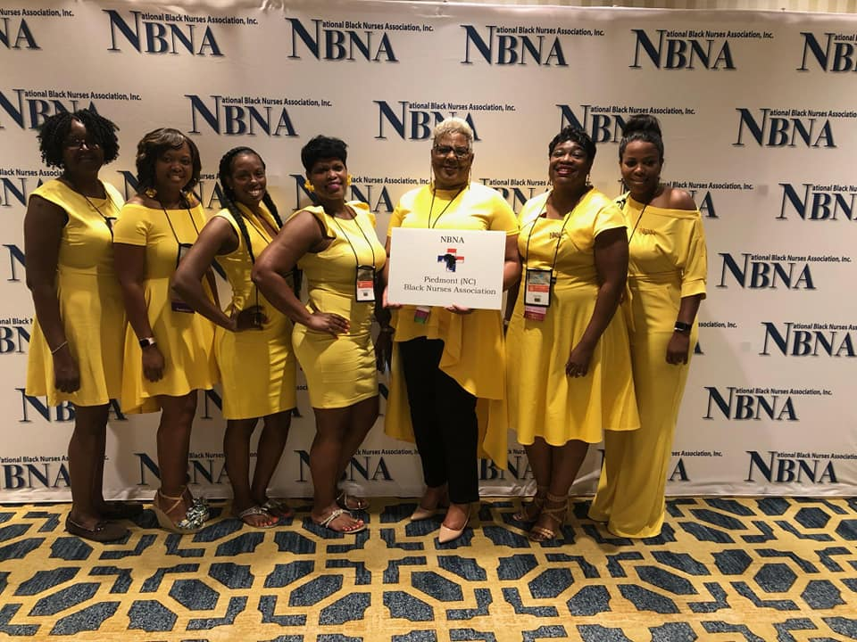
From Humble Beginnings
Notes:
When we first started, PBNA had 17 members. We then went on to be chartered on July 25, 2019 as a local chapter of the National Black Nurses Association. To date we have 44 active members and are continuing to grow. Prior to this chapter, there hasn’t been a local representation of NBNA which left a void as many members were initially members at large or have had experience with other chapters in former areas of residence. As a chapter, we are proud to serve Mecklenburg, Rowan, Iredell, and Cabarrus communities. The mission of PBNA is to represent and provide a forum for Black nurses to advocate and implement strategies to ensure access to the highest quality of healthcare for persons of color.

Slide 3
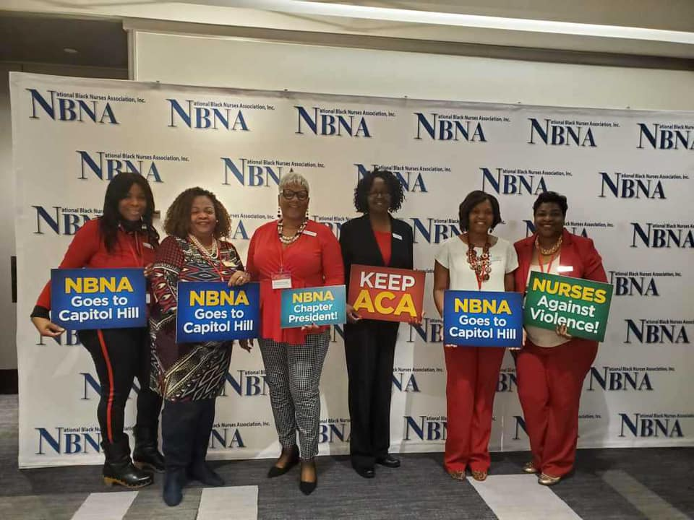
Advocacy
We bring awareness to health disparities in communities of color.
We lobby for health initiatives and legislation that supports healthcare access and diversity.
Notes:
Advocacy seeks to ensure that all people in society are able to: have their voice heard on issues that are important to them, protect and promote rights, in addition to having their views and wishes considered in decision-making. This is an important part of being a presence in the community. At PBNA we aim to empower community members to be more involved in their healthcare, make informed decisions, and educate themselves. We celebrate diversity of thought and practice and seek to create that momentum needed to strengthen our communities and bring about an impactful change.

Slide 4
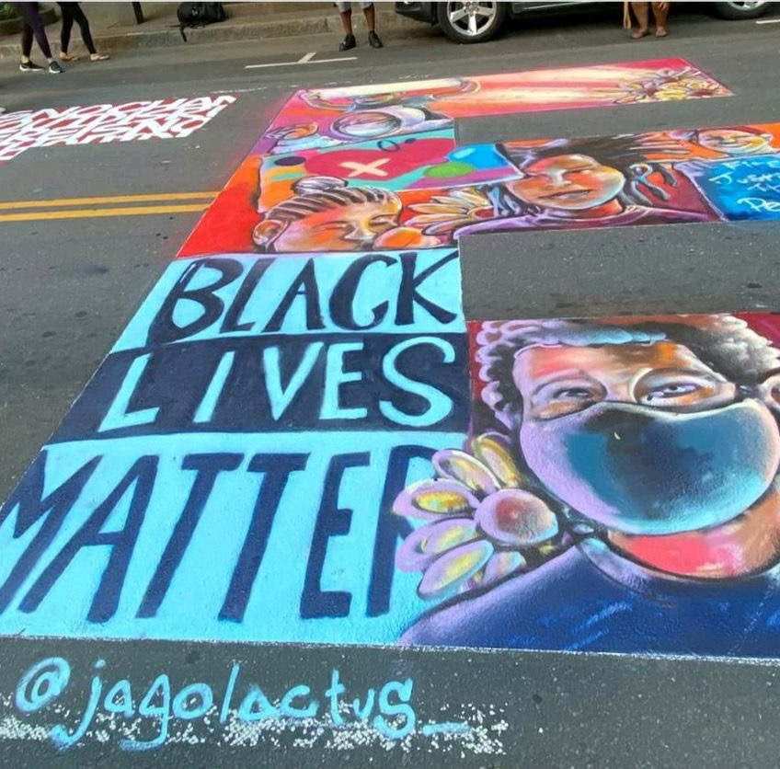
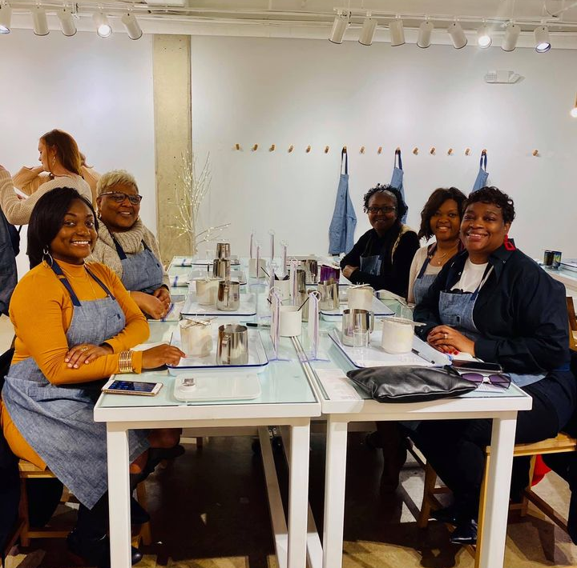
Support
Candle Making
Black Live Matters Mural: Charlotte, NC
Notes:
This brings us to our second point of impact, support. In order for an entity to be successful, it needs support from internal and external factors. PBNA partners with numerous groups and organizations to help put forth our best efforts in whatever project we undertake. Whether it’s a health fair or food drive, team work makes the dream work. External support helps to drive our initiative while fostering collaborative environments where members can network and be included in a greater good. PBNA also focuses on internal support for its members. As a house cannot stand without a solid foundation, our organization cannot be strong without our dedicated members. At PBNA, we take time to educate our members of what’s new in nursing, how we can best care for ourselves and others, in addition to creating a safe space where we can vent, bounce ideas off of each other, and simply talk about challenges we are facing or celebrations we are having.

Slide 5
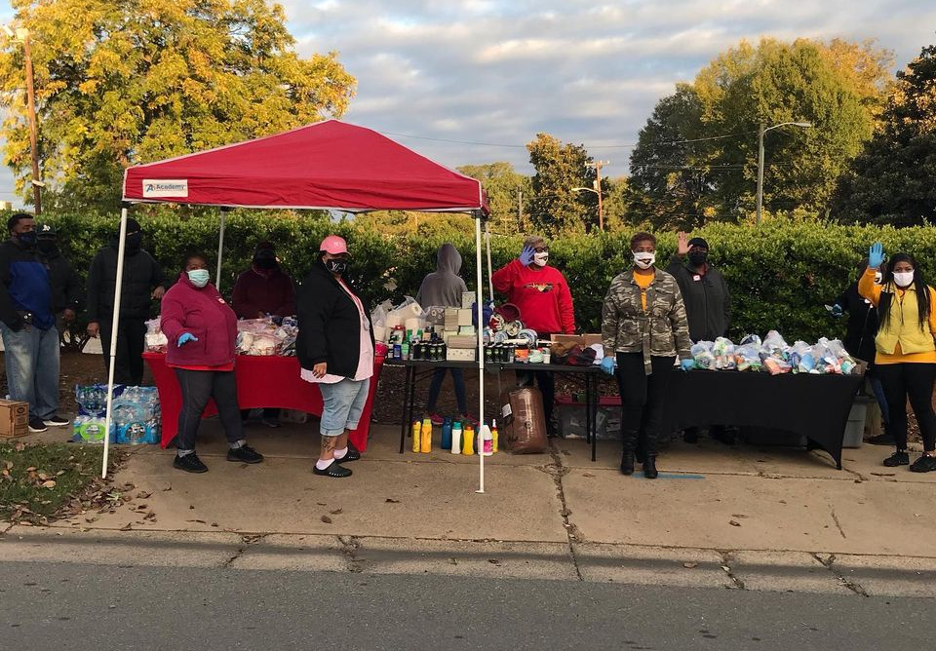

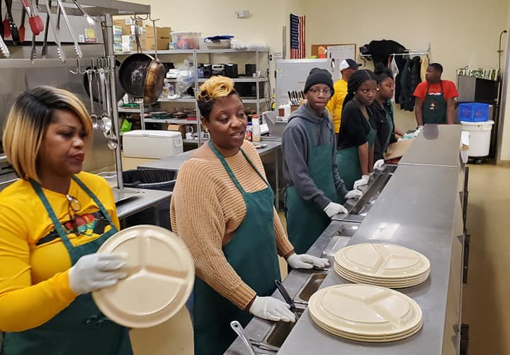
Service
“There is no higher religion than human service. To work for the common good is the greatest creed.”
-Woodrow Wilson
“The best way to find yourself is to lose yourself in the service of others.”
-Mahatma Ghandi
Notes:
Our third point of impact is service. Community service and giving back are the heart of PBNA. Each year we host and participate in a number of community service event including but not limited to: health fairs, supply drives, charitable donations and fundraising; in addition to helping at local organizations such as food banks. This not only keeps our members engaged and in connection with the communities that we serve, but it also gives us a deeper appreciation of the needs of those surrounding us and how we can best help. Service encapsulates both advocacy and partnership to ensure that each event and each endeavor has maximum impact and benefit to the communities that we serve.

Slide 6
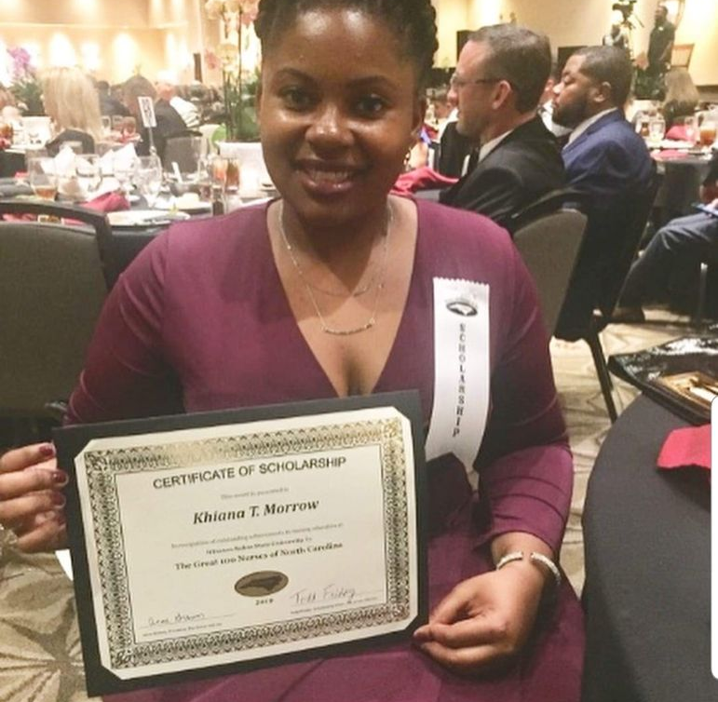
Scholarship
Giving back to our future in nursing.
Notes:
Our final point of impact the scholarship. Scholarship helps to ensure the continuation of not only this organization, but the future of nursing. By providing scholarships for budding nursing students we are investing and our communities by investing In our futures. At PBN A, we use both young and old to put forth our mission and we encourage the young to get involved and use their strength and vigor for good. Not only do we support aspiring nurses financially, we also support the struggle that they face going through nursing school and finding jobs thereafter. We embrace this challenge and support our future generations.

Slide 7
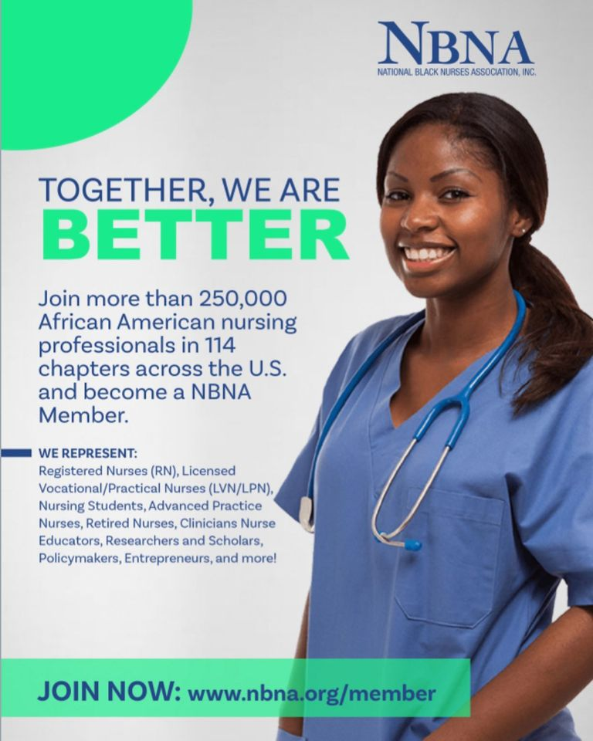
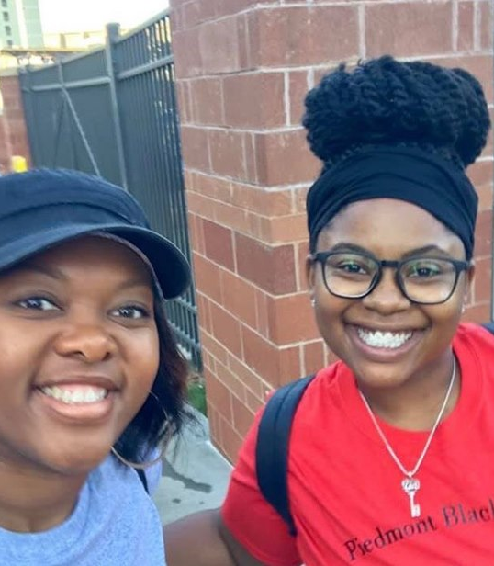
Mentorship
Notes:
Mentorship is important from building connections between our members. On a national level and NBNA has a Collaborative Mentoring Program for nurses of all levels to provide support and empowerment during various transitional periods such as graduating from nursing school or transitioning into leadership roles on the job. On a local level, we too seek to partner with our members and help support their goals and future endeavors.

Slide 8
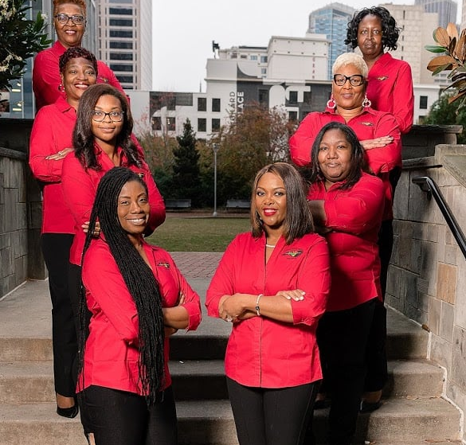
How To Get Involved?

Slide 9

Where You Can Find Us
NBNA Website: www.nbna.org
Chapter Website: https://www.piedmontbna.com
Facebook Group: Piedmont Black Nurses Association
Instagram: @piedmont_bna
Email: piedmontblacknurses@gmail.com
Notes:
Here I will briefly mention each outlet.

